Slide 1


Project number: 2023-1-CZ01-KA121-VET-000135958
Matěj Olšovský
I3.A
Automatization and Robotics
Thessaloniki, Greece 2024

Slide 2
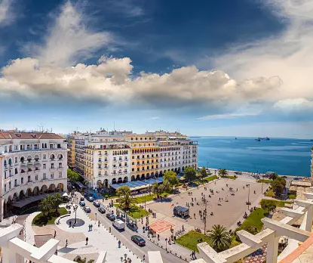
Content of presentation
Place and duration of stay​
Company​
Organizational structure of the company​
Description of performed activities​
Leisure activities​
Benefit - acquired skills

Slide 3
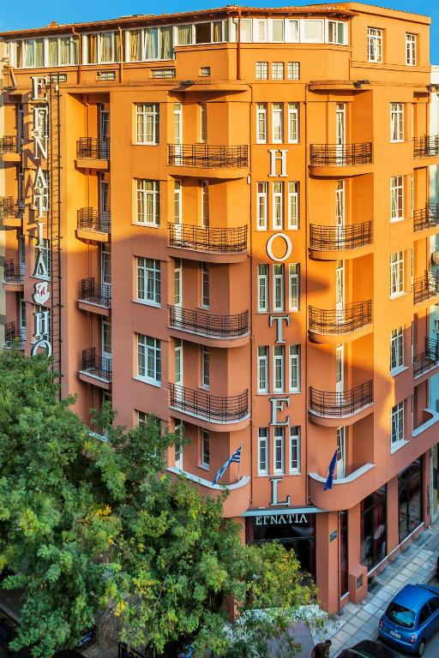
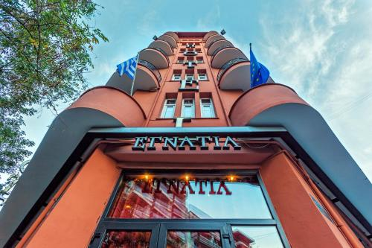
Place of stay/duration
We stayed in Egnatia Hotel in Thessaloniki for 3 weeks from 19.05.2024 to 08.06.2024.

Slide 4
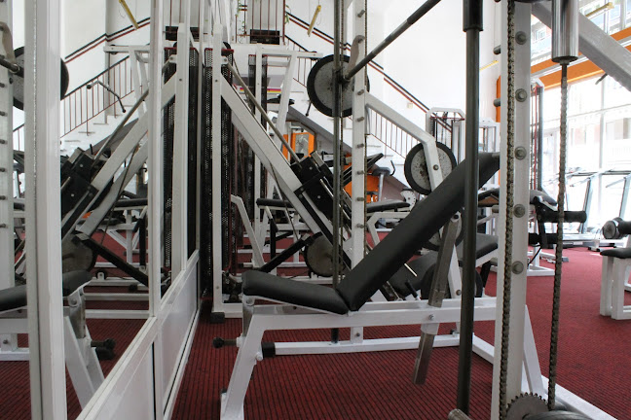
Gym Athlisis
The Athlisis Fitness Center, located in the heart of Thessaloniki, offers modern equipment and a wide range of fitness programs for all fitness levels. The center prides itself on its professional team of trainers who are ready to help clients achieve their goals. With its pleasant atmosphere and high-quality services, Athlisis has become a popular choice for anyone looking to improve their fitness.

Slide 5
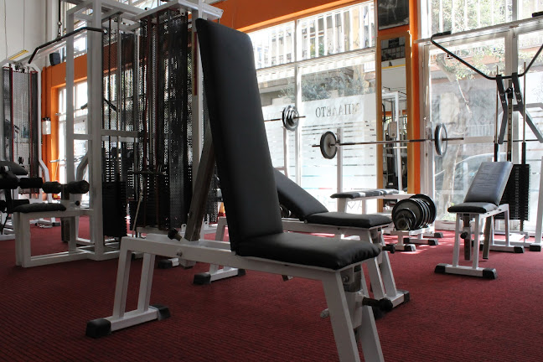
Organizational structure of company
Owner
Cleaners
Trainers
Maintainers

Slide 6
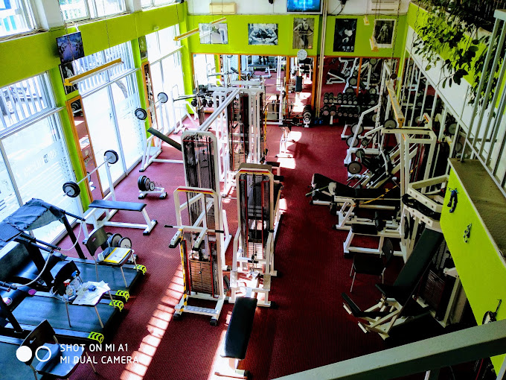
Performed activities
We worked in the gym from 9 am to 1 pm every day for the whole 3 weeks.
The gym owner showed us how it works in the gym and how he manages it.
We learned about:​
Nutrition​
How to maintain and manage a gym
How to exercise the muscles in the whole body​
Injury prevention

Slide 7
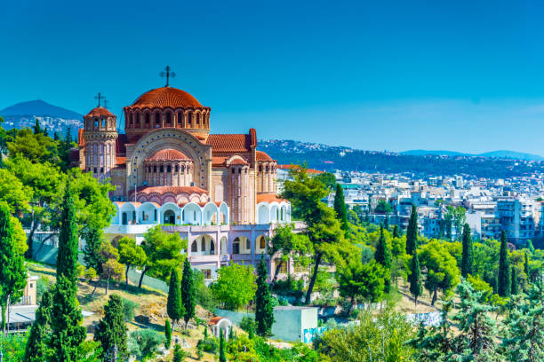
Leisure time activities
We visited some tourist attractions with a guide such as: Arch of Galerius, Saint Sophia Church and more.
Few times we went to the beach, or we visited Pozar baths and water falls.
When we had a free time, we visited lot of monuments and historical architectures and we enjoyed it a lot.

Slide 8
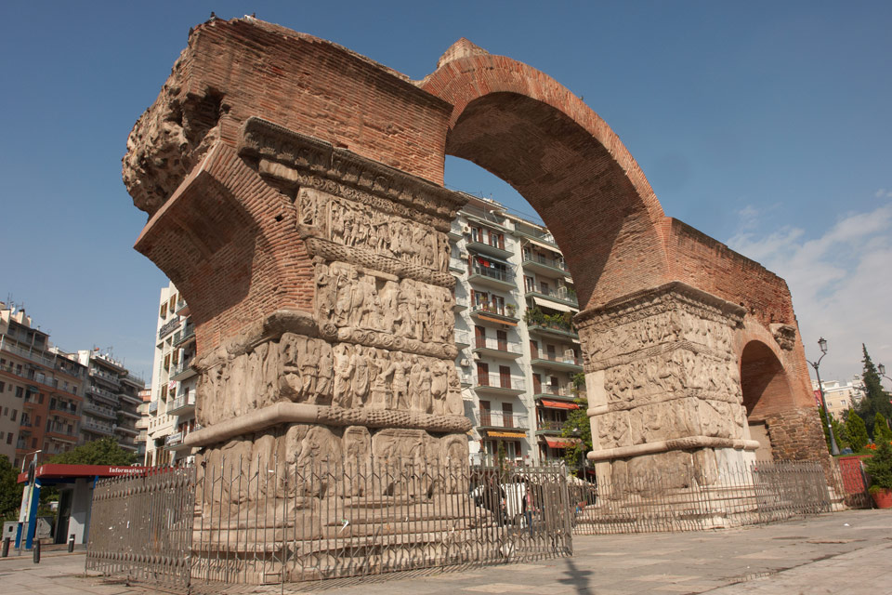
Arch of Galerius

Slide 9
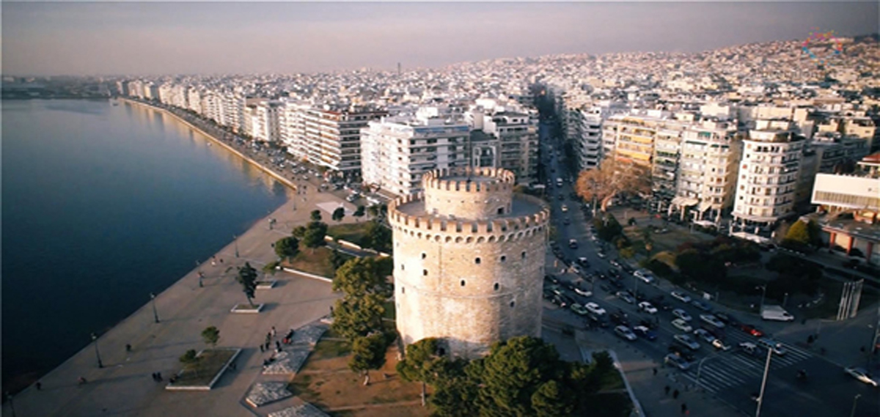
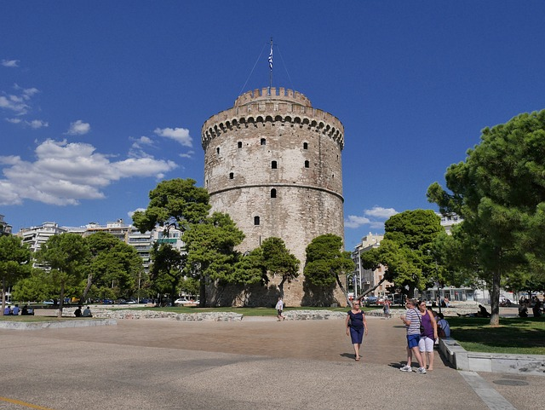
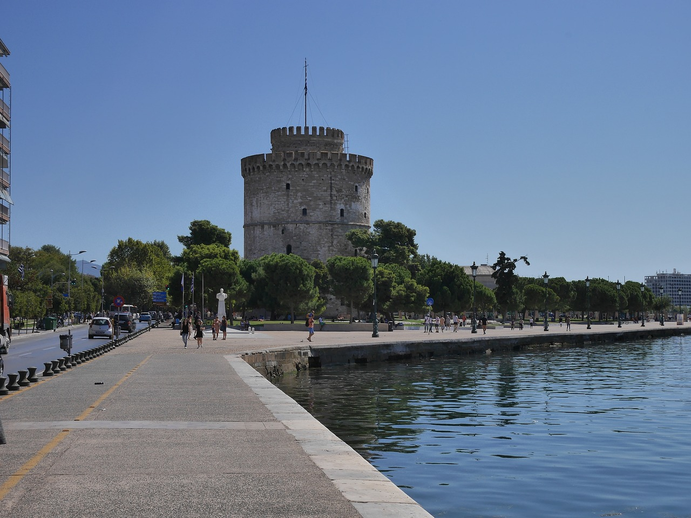
White Tower

Slide 10
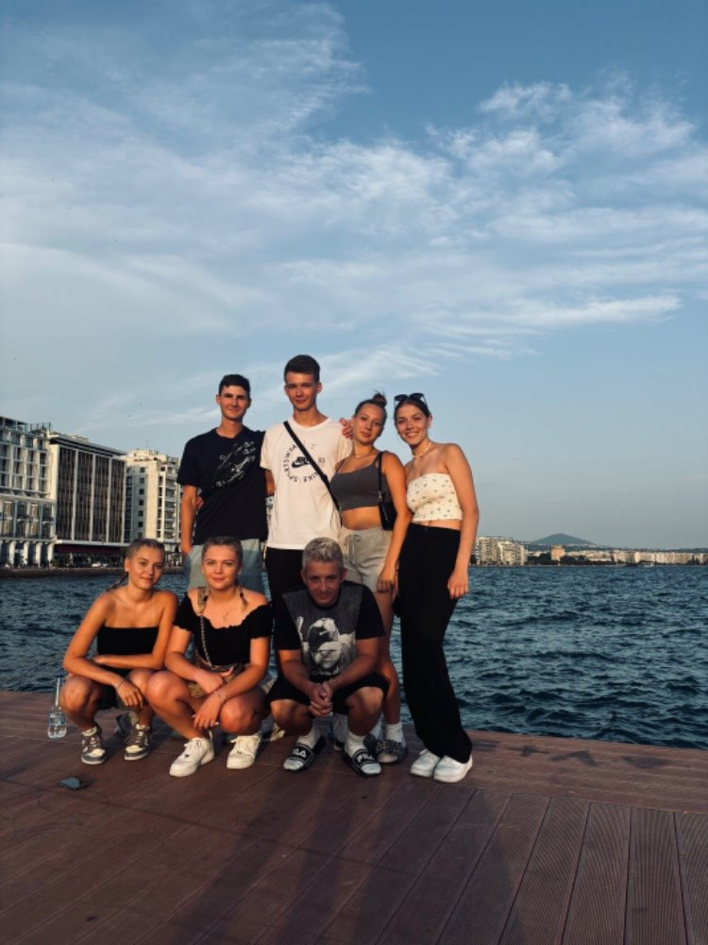
Acquired skills
I improved my English skills​
I learned new things about Greek culture and monuments​
I earned experience with sports management​
I improved my communication and talking skills

Slide 11
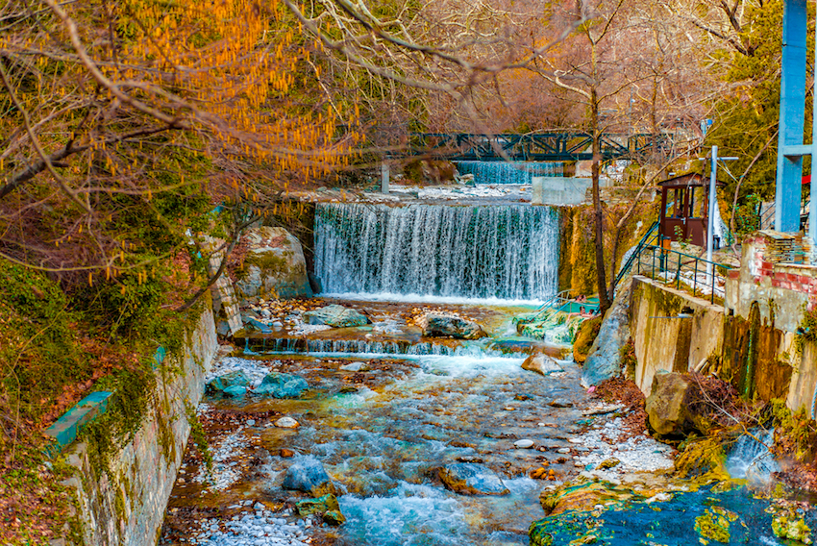
Thank you for your attention.

